Slide 1
Neural Network Classification On MNIST Handwritten Digit Dataset
By Nicholas Nordstrom

Slide 2
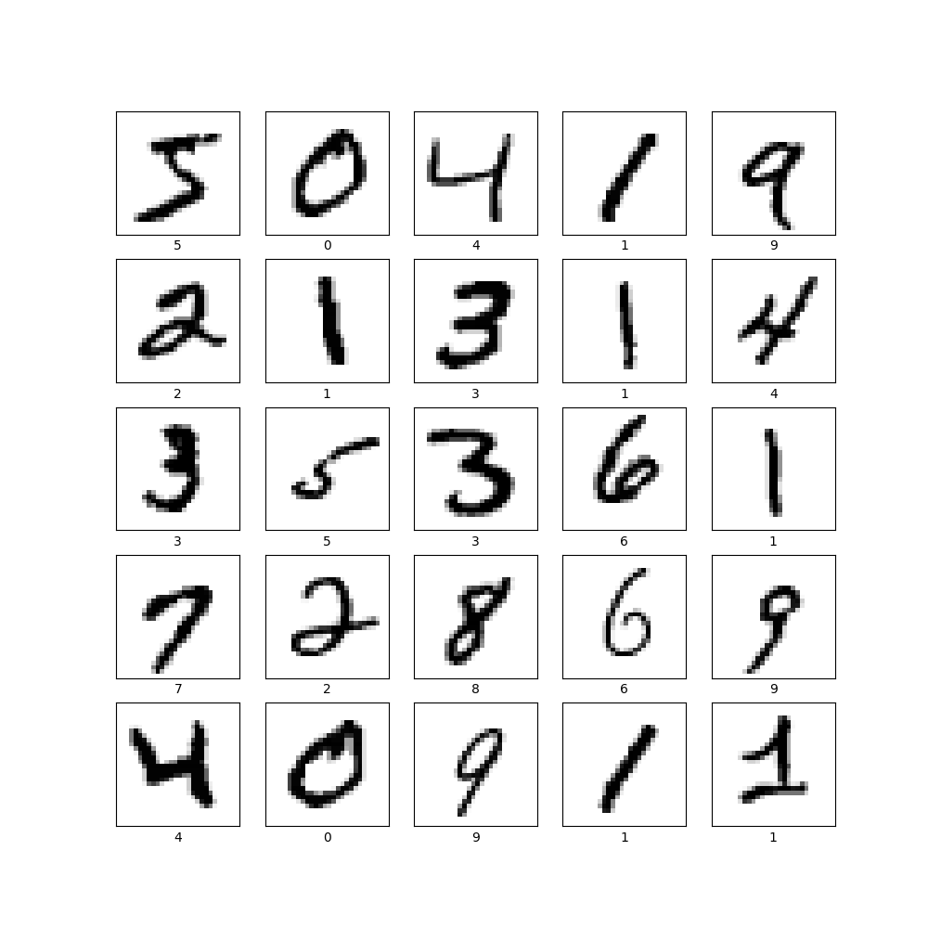
Understanding MNIST Digit Dataset
Dataset consists of 28x28 images of handwritten digits
Some digits use different styles / font
Training set has 60,000 images, testing set has 10,000 images

Slide 3

Classification Neural Network
Input layer shape 28x28 flattens the image into a 1D array
Dense layer with 128 neurons with ‘relu’ activation function
Dense output layer with 10 neurons indicating classification

Slide 4
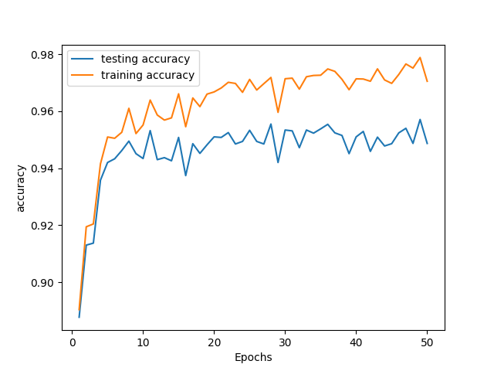
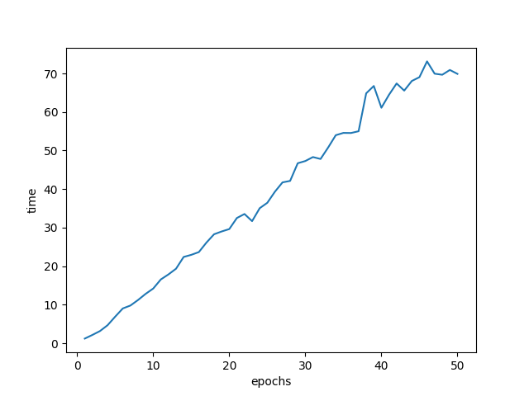
Training & Testing
Model was trained on the entire dataset multiple times (this is the epoch)
Each epoch model weights are adjusted

Slide 5
Preprocessing
I preprocessed the images by converting them from an integer scale (0 to 255) to a float scale (0 to 1)

Slide 6
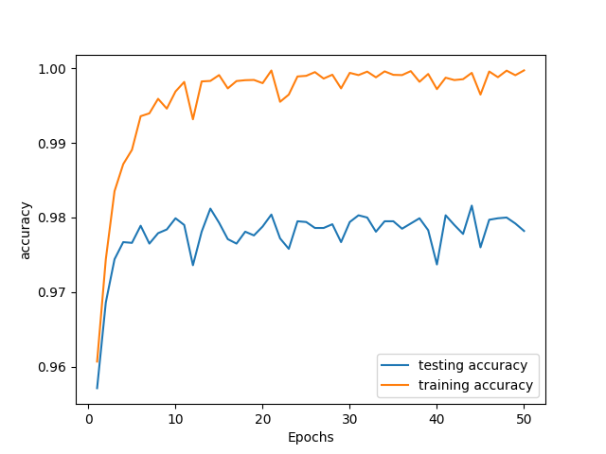
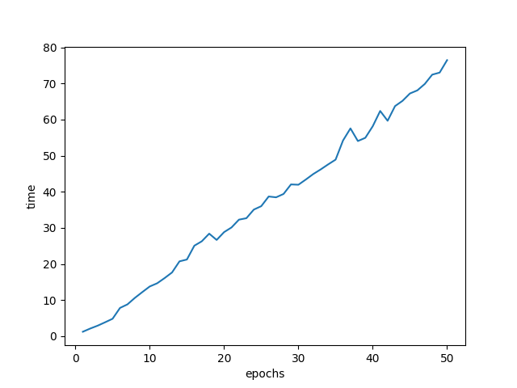
Training & Testing After Preprocessing
Model was trained with different epoch values and tested to find the best epoch parameter value

Slide 7
Comparing Results Without Preprocessing
Time to train for images with and without preprocessing were practically identical

Slide 8
Q&A
Any Questions?

